Slide 1
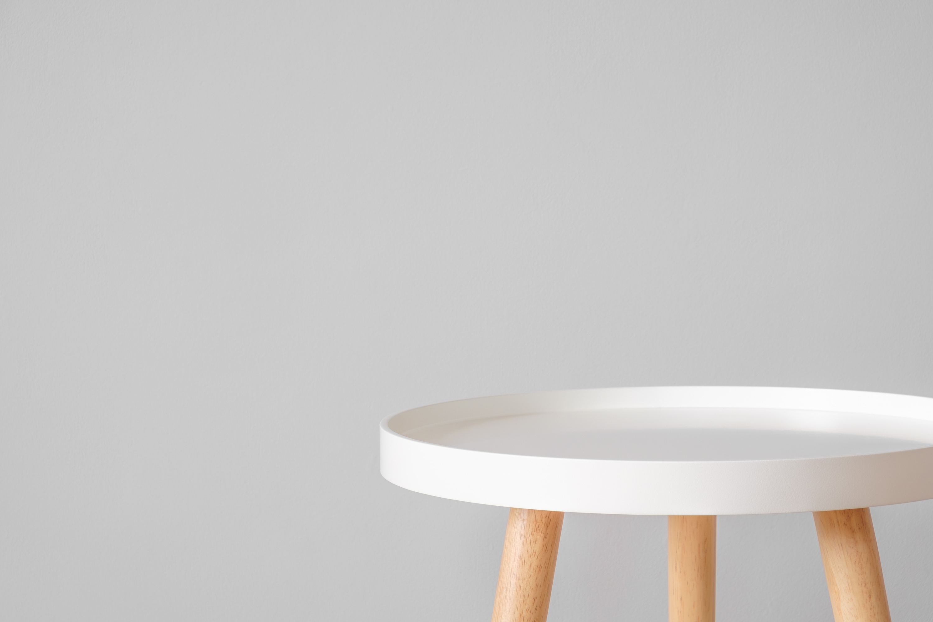

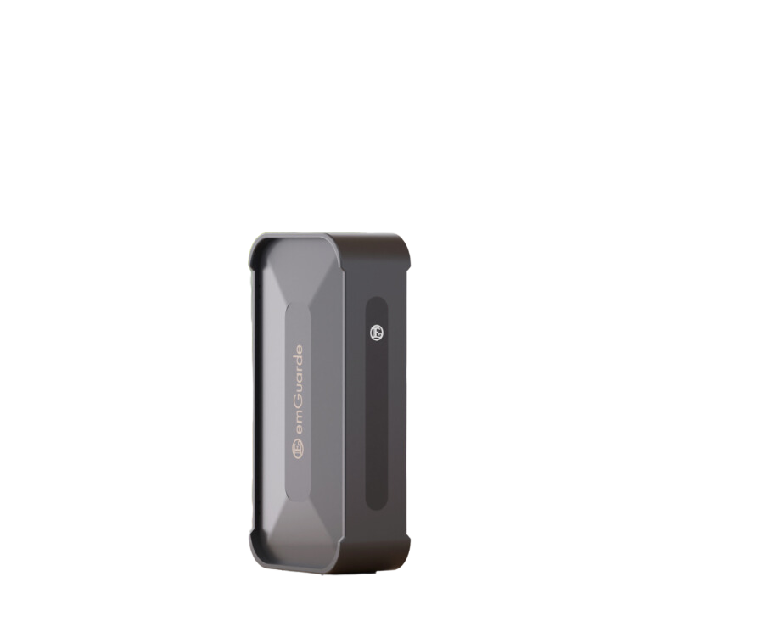

Enagic (Malaysia) Sdn. Bhd.
201101042983 (971103-W) AJL No. 931978
emGuarde
emGuarde
Your Environment Harmonizer
Your Environment Harmonizer

Slide 2

Effective in suppressing targeted
electromagnetic noise radiation
between 3MHz to 1000MHz
Effective in suppressing targeted
electromagnetic noise radiation
between 3MHz to 1000MHz

Slide 3

Designed to integrate seamlessly in any situation, whether in the comfort of your own home, or even at work!
Designed to integrate seamlessly in any situation, whether in the comfort of your own home, or even at work!

Slide 4

Coverage up to
8 meters in circumference!
Coverage up to
8 meters in circumference!

Slide 5




Increase Energy Level:
Rejuvenate & Stay Focused.
Reduce Stress & Rest Well:
Achieve Rapid Eye Movement (REM) sleep.
Improves Well-Being:
Enhance your environment & experience the best that you can be.

Slide 6

Always on, always protected
When the light is on, you are protected.

Slide 7
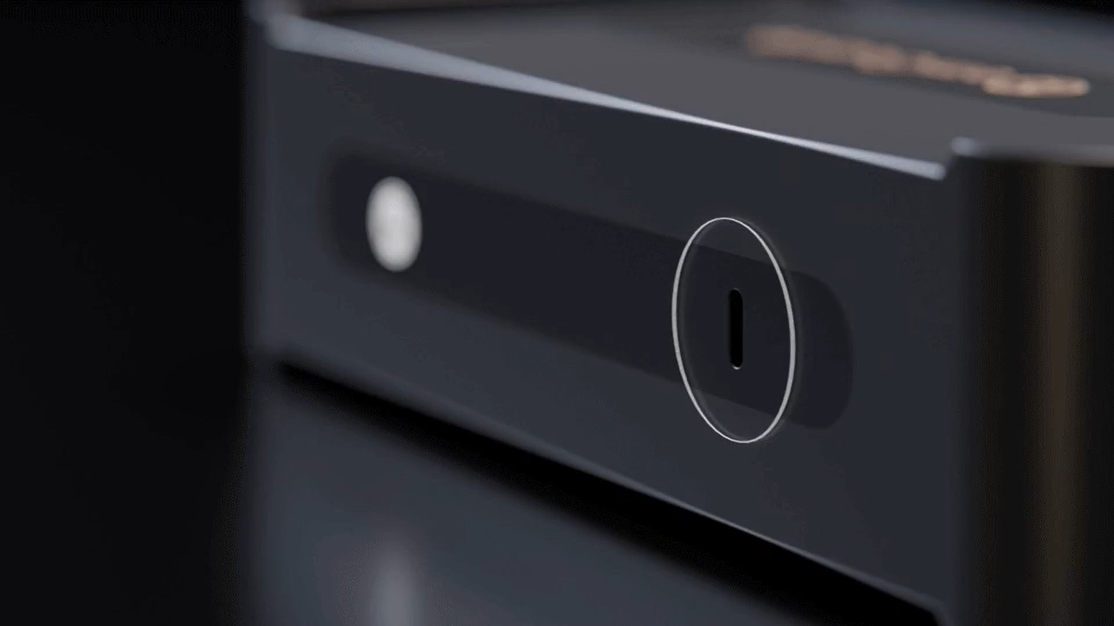
Anywhere, Anytime
Compatible with regular USB-type C charging adaptors worldwide.

Slide 8
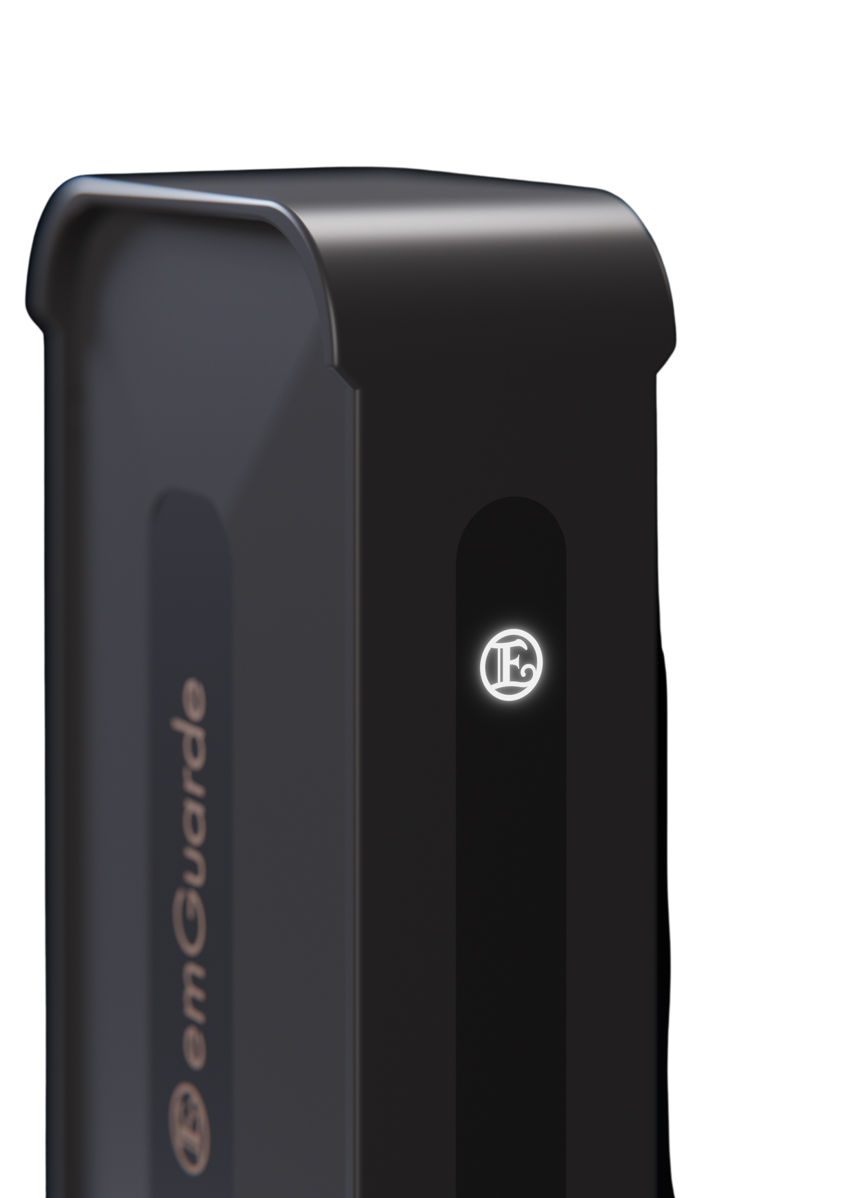
Small in a big way
Creates an impact so
much larger than it size.

Slide 9
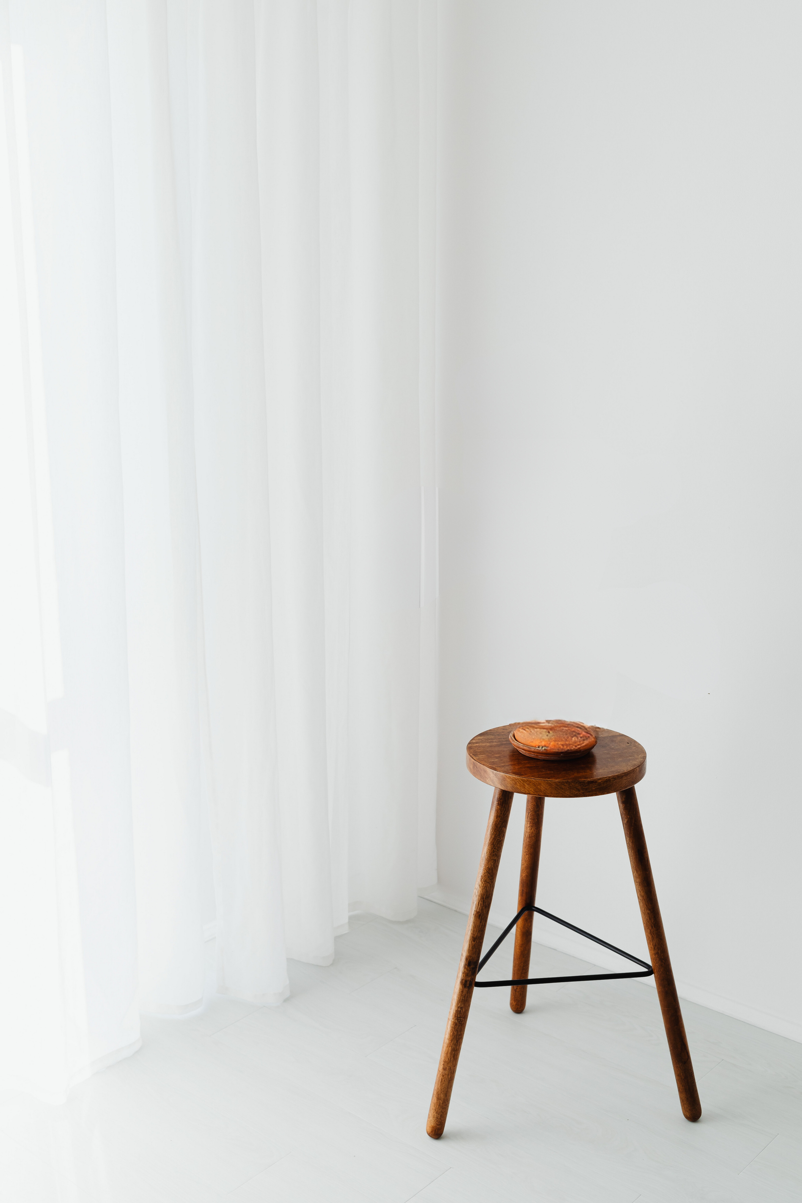
Visit our websites; www.enagic-my.com and www.emguarde.com
for more information.
Visit our websites; www.enagic-my.com and www.emguarde.com
for more information.
Change Your Environment,
Change Your Environment,
Change Your Life!
Change Your Life!

