Slide 1
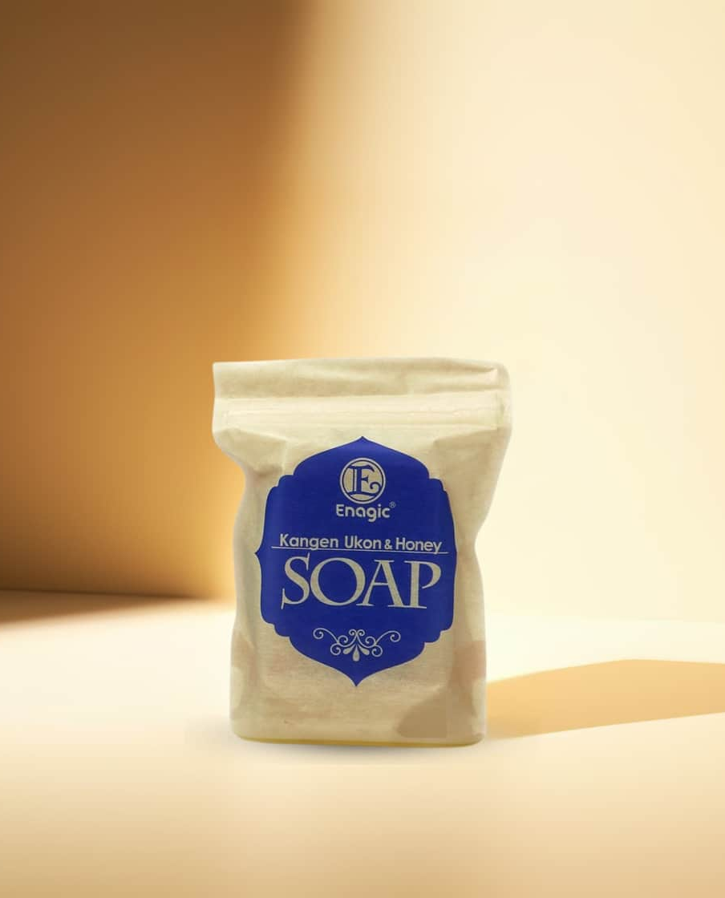
Enagic Malaysia Sdn. Bhd.
201101042983 (971103-W) AJL No. 931978
KANGEN UKON
& HONEY SOAP
All natural living soap made to rejuvenate your skin!

Slide 2
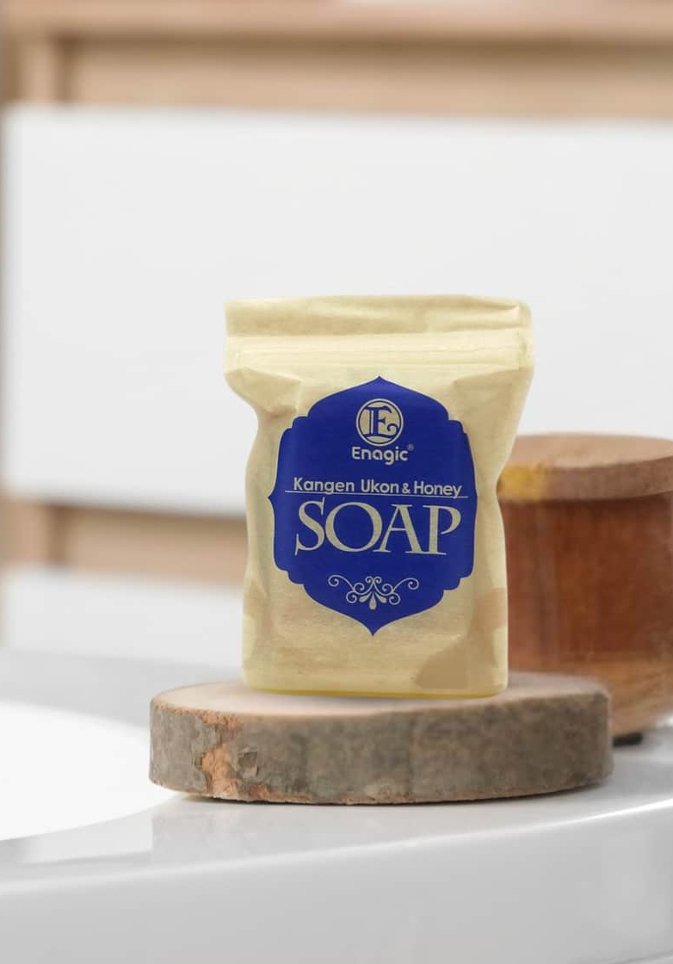
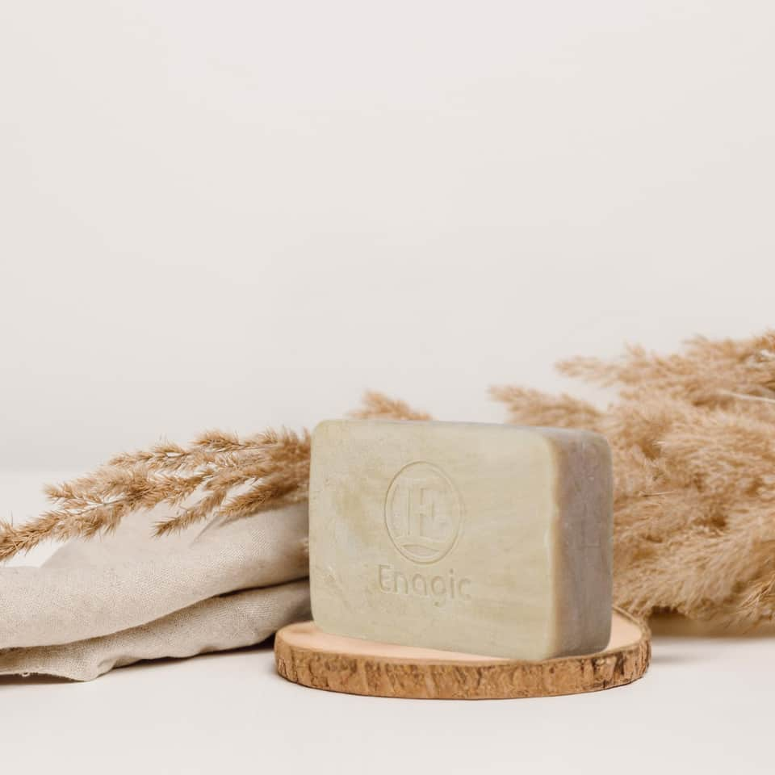
ABOUT
Kangen Ukon & Honey Soap is natural soap by Enagic, crafted using traditional frame kneading method.

Slide 3
KANGEN UKON & HONEY SOAP
WHAT WE DO
This artisanal process blends the powerful benefits of turmeric, Okinawa lime, honey and other natural ingredients to gently cleanse and deeply nourish the skin.

Slide 4
NATURAL
INGREDIENTS
9
natural ingredients - free from mineral oils, and synthetic activators.

Slide 5
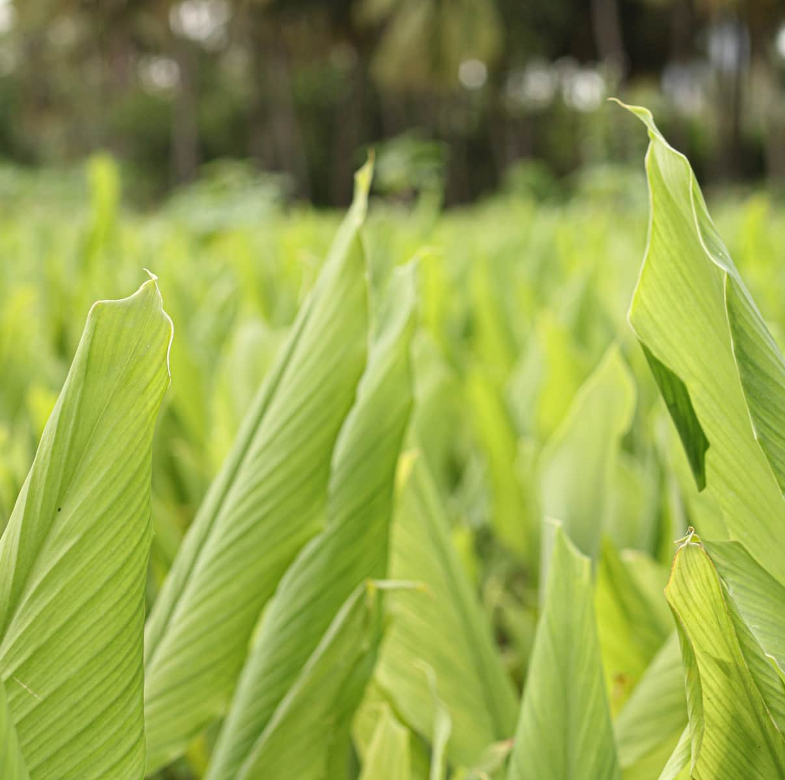
Our turmeric is specially grown in the rich, nutrient-dense soil of Okinawa, Japan, where it's carefully cultivated by dedicated farmers in a land abundant with natural minerals.
SOURCE
KANGEN UKON & HONEY SOAP

Slide 6
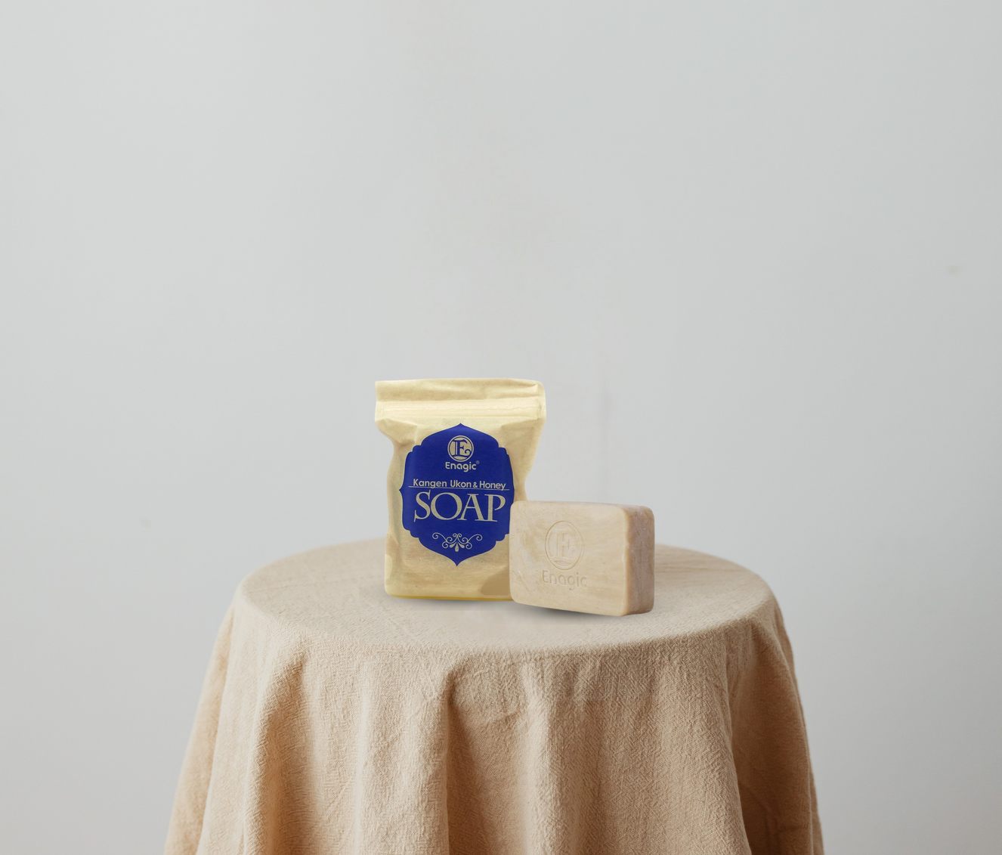
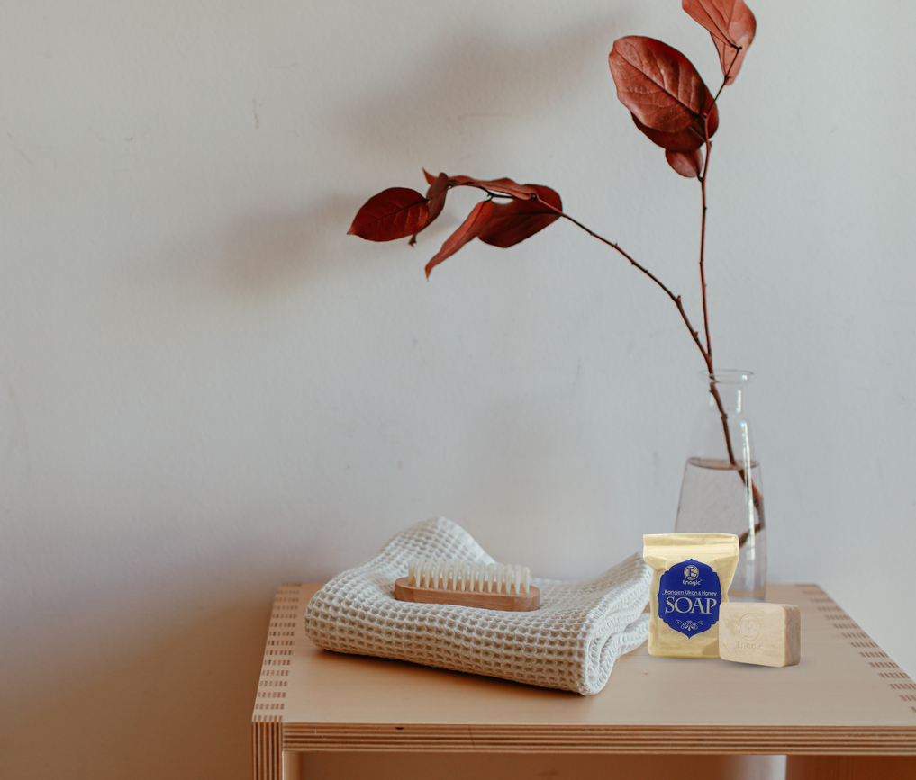
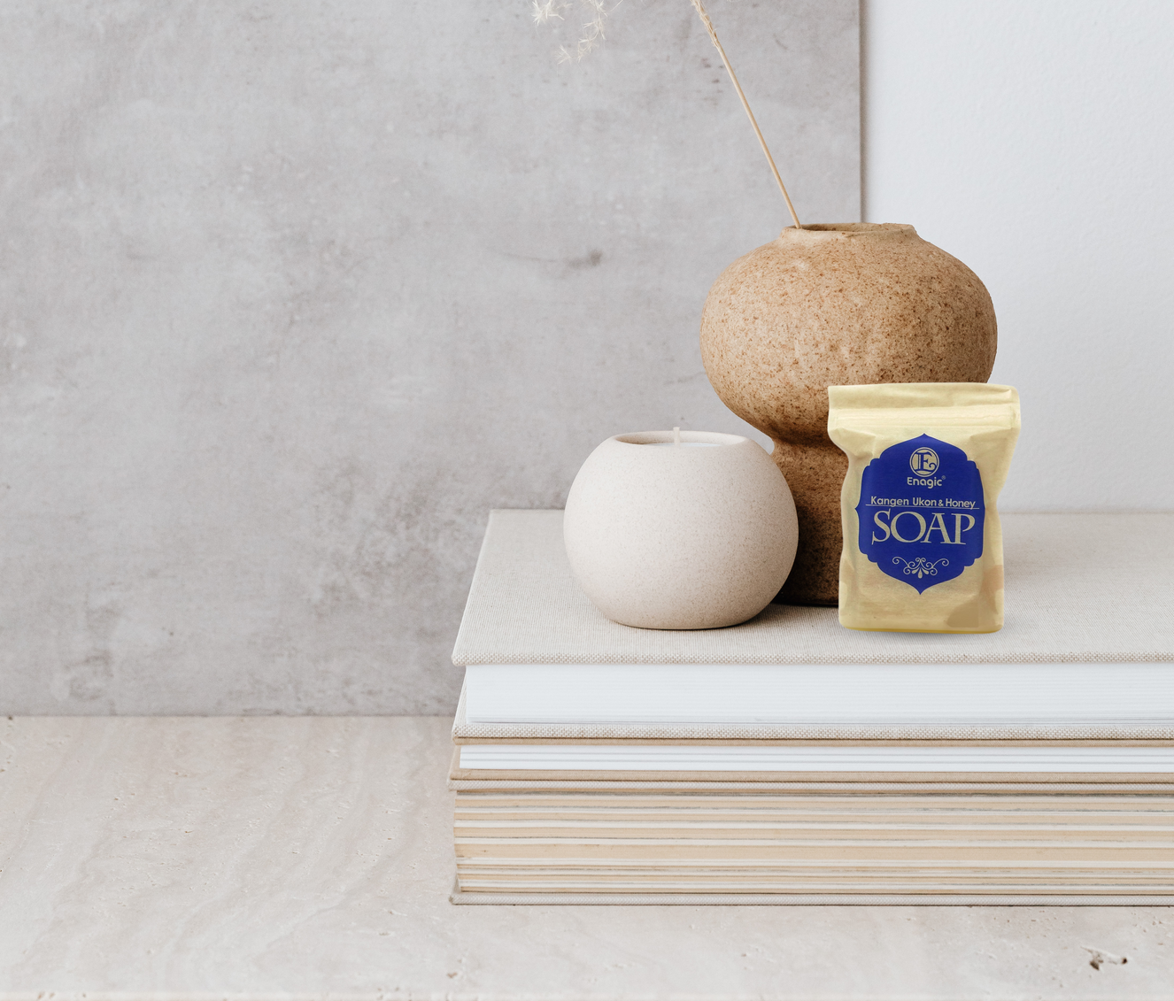
OUR
INGREDIENTS
Kangen Ukon & Honey Soap — beautifully crafted using only 9 wholesome, natural ingredients for skin-loving goodness.

Slide 7
KANGEN UKON & HONEY SOAP
Tallow, Aqua, Cocos Nucifera (Coconut) Oil,
Sodium Hydroxide, Black Strap Powder, Honey, Curcuma Longa (Turmeric) Root Oil, Citrus Depressa Fruit Water, Simmondsia Chinensis (Jojoba) Seed Oil, Melaleuca Alternifolia (Tea Tree) Leaf Oil.
Tallow is derived from animal source.
OUR ingREDIENTS

Slide 8
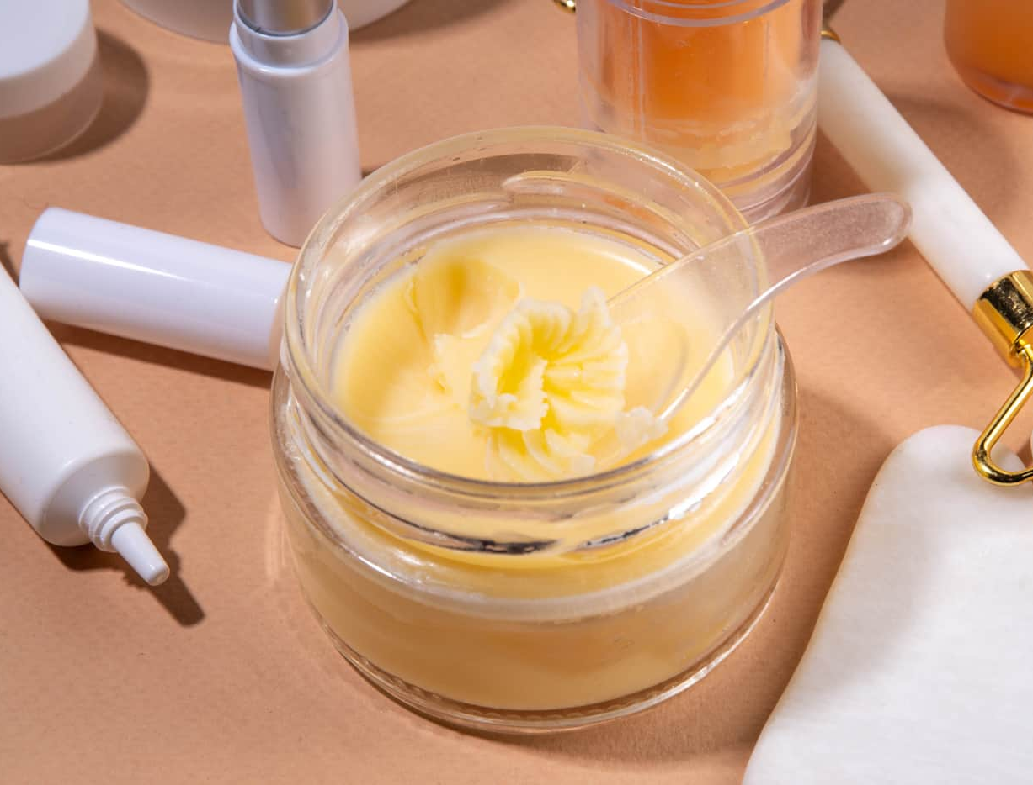
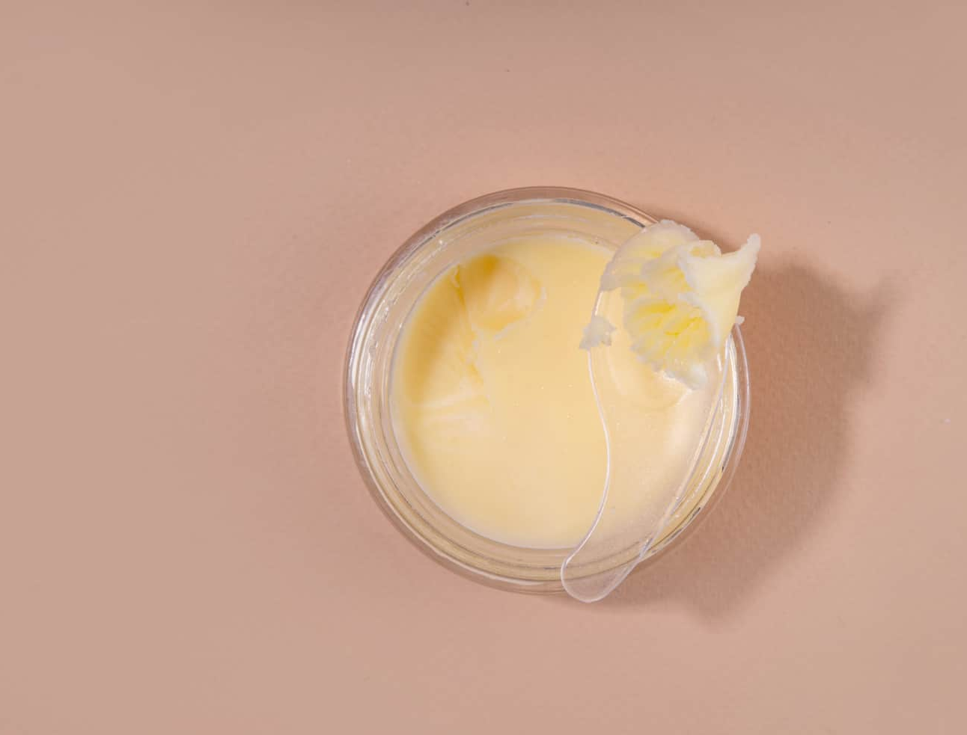
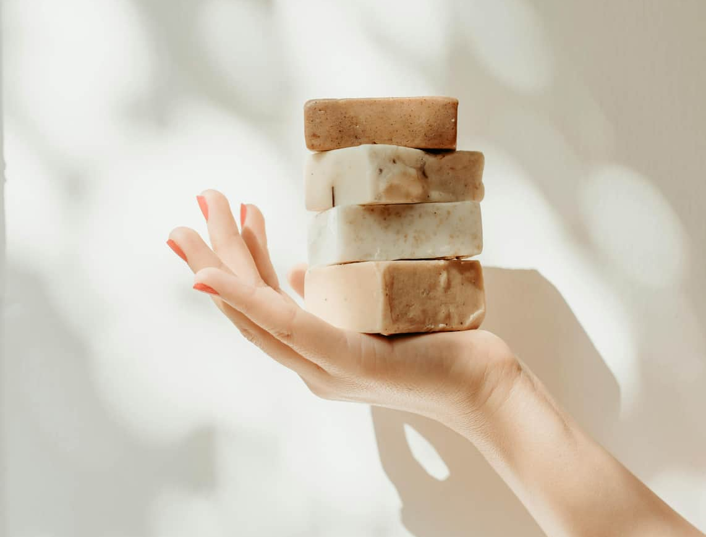
Tallow has been used in soap-making for centuries as a sustainable, natural alternative to synthetic ingredients.
Tallow
is derived from animal source.
Tallow is rich in fatty acids similar to those found in human skin, helping to nourish and deeply hydrate without clogging pores.

Slide 9
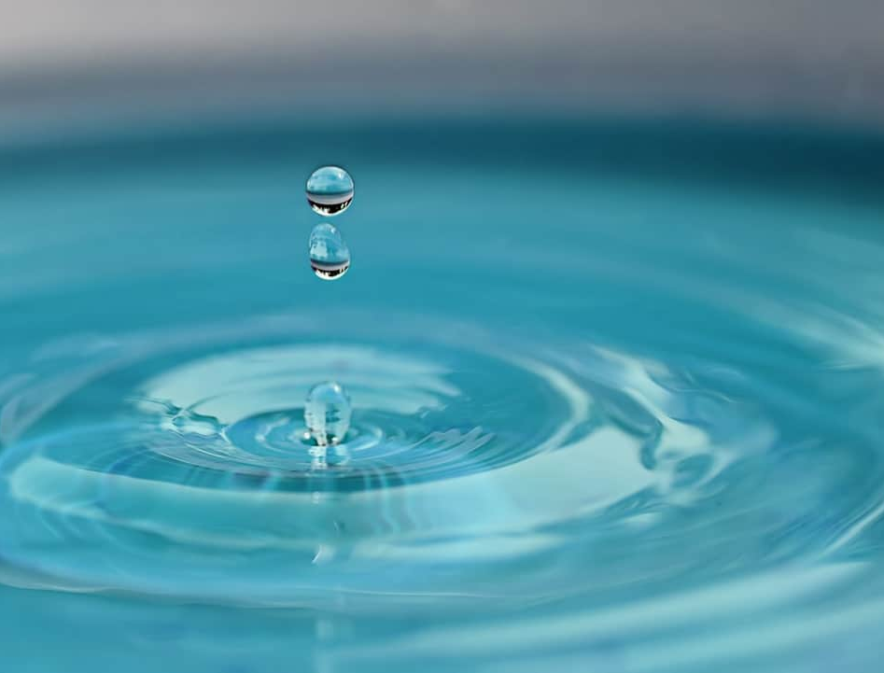
It ensures that all ingredients, including honey or oils, are evenly distributed.
Water
also known as aqua.
Water helps activate the soap when used, producing a rich, creamy lather that aids in cleansing.

Slide 10
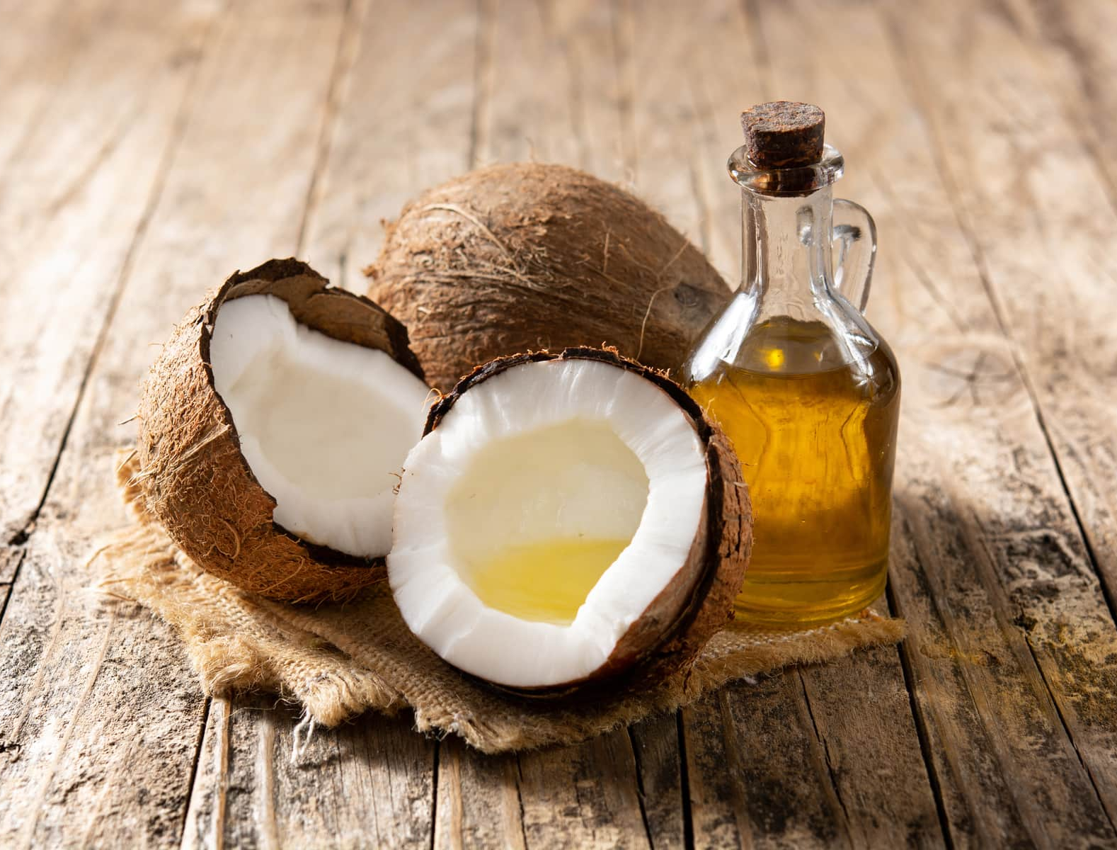
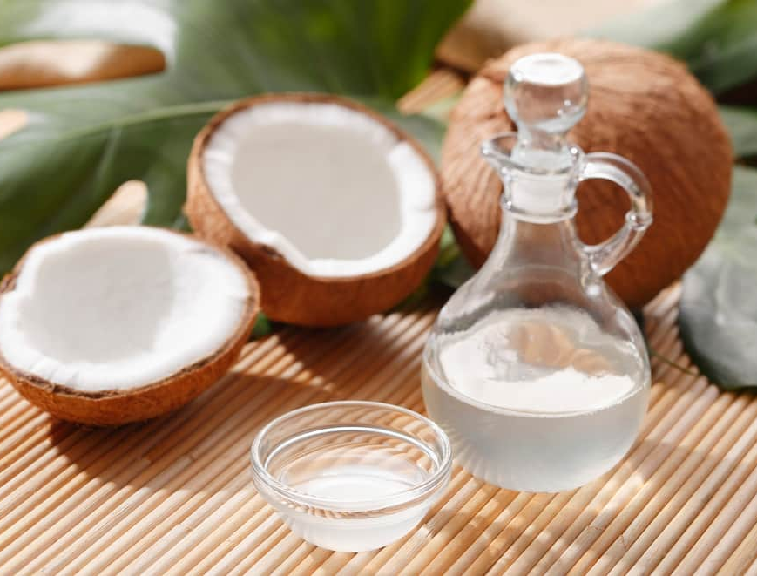
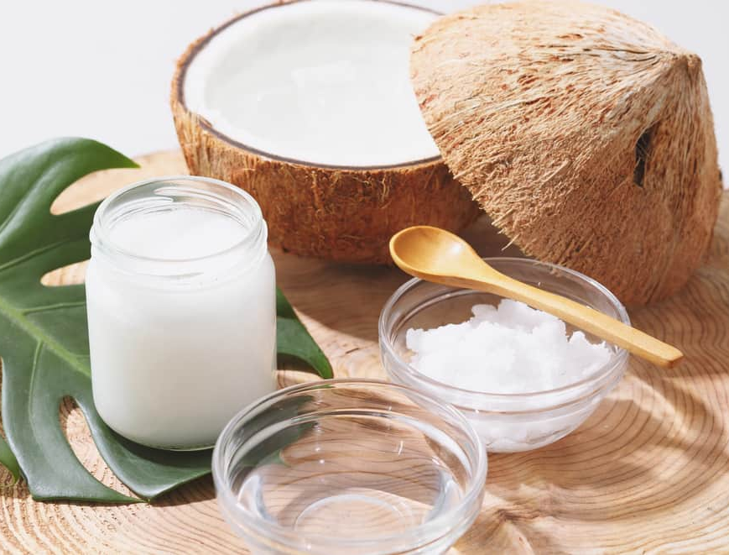
Its natural antimicrobial properties help keep the skin clean and protected.
Coconut oil
also known as Cocos Nucifera Oil.
It effectively removes dirt, excess oil, and impurities without stripping the skin’s natural moisture.

Slide 11
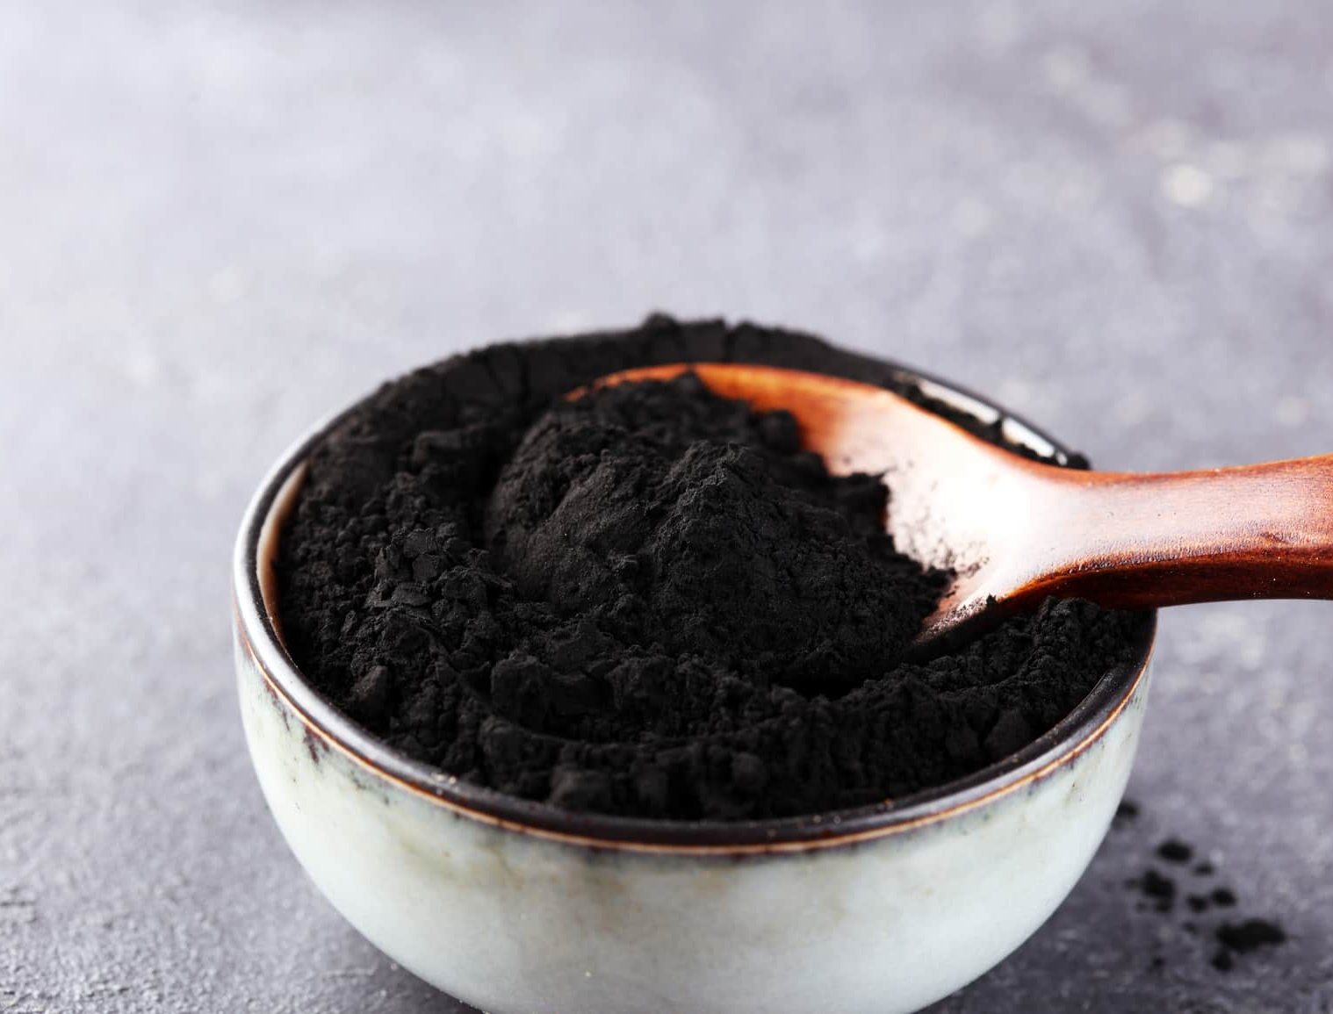
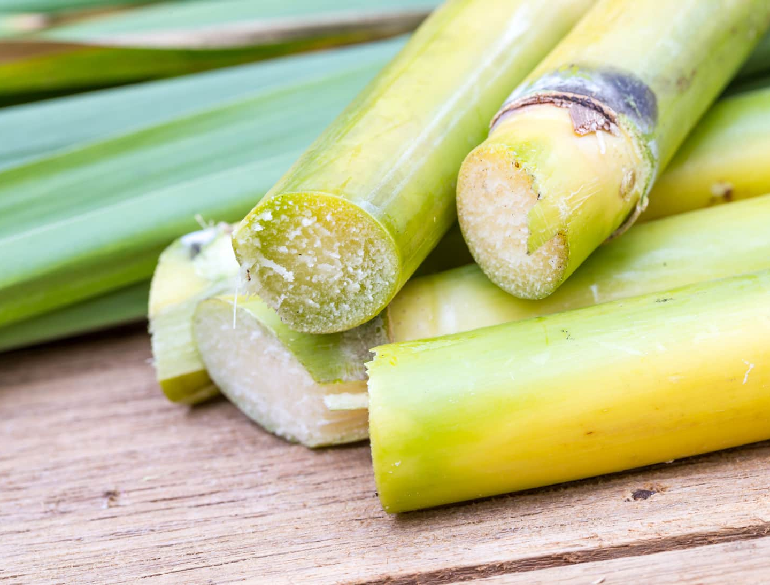
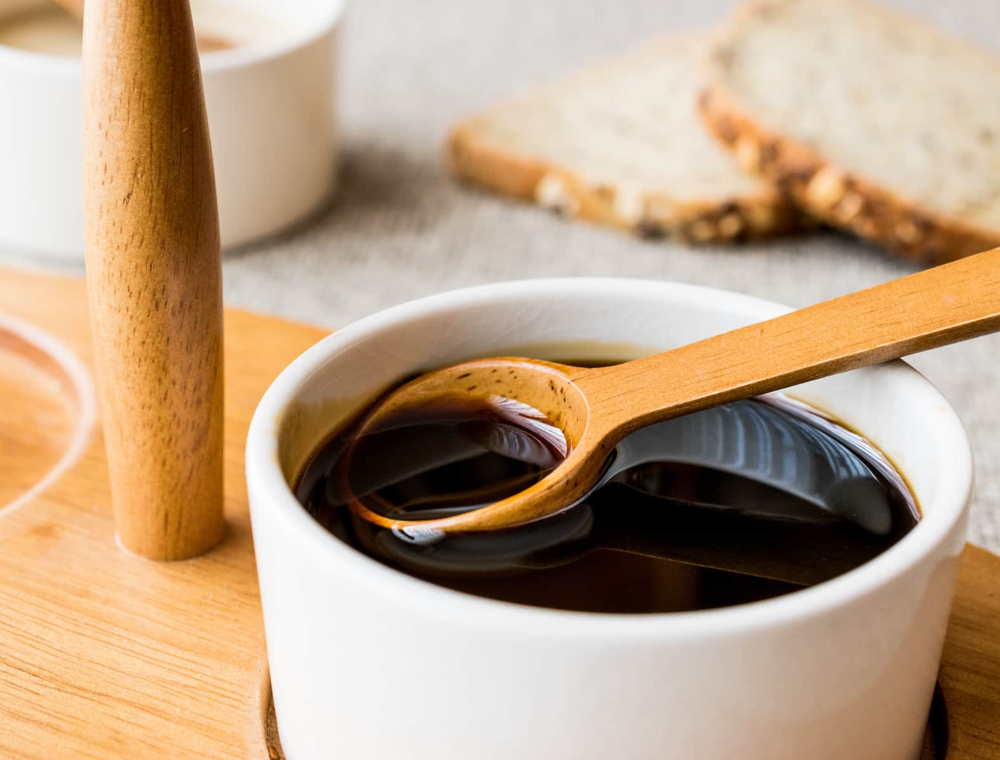
It also contains excellent moisturizing components, which keep the skin hydrated and protect it from dryness.
Black Strap Powder
Black Strap Powder is known for its richness in antioxidants and minerals.

Slide 12
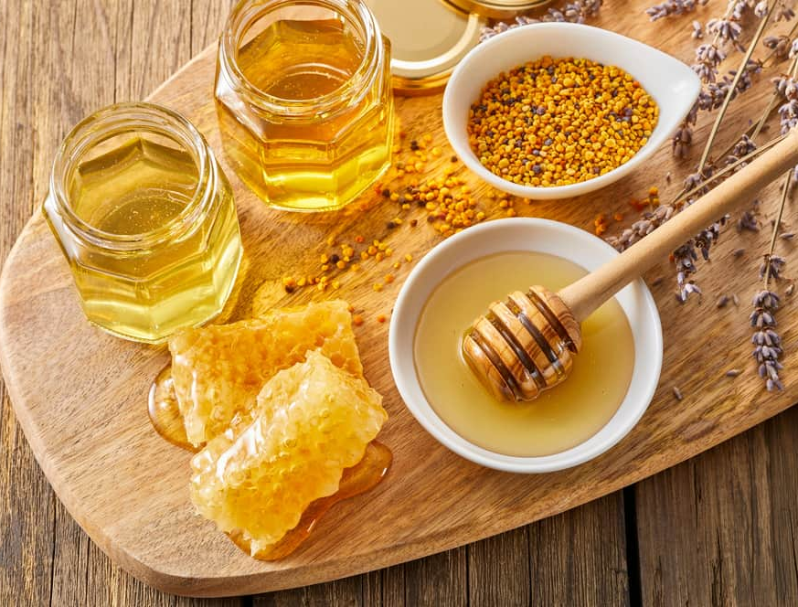
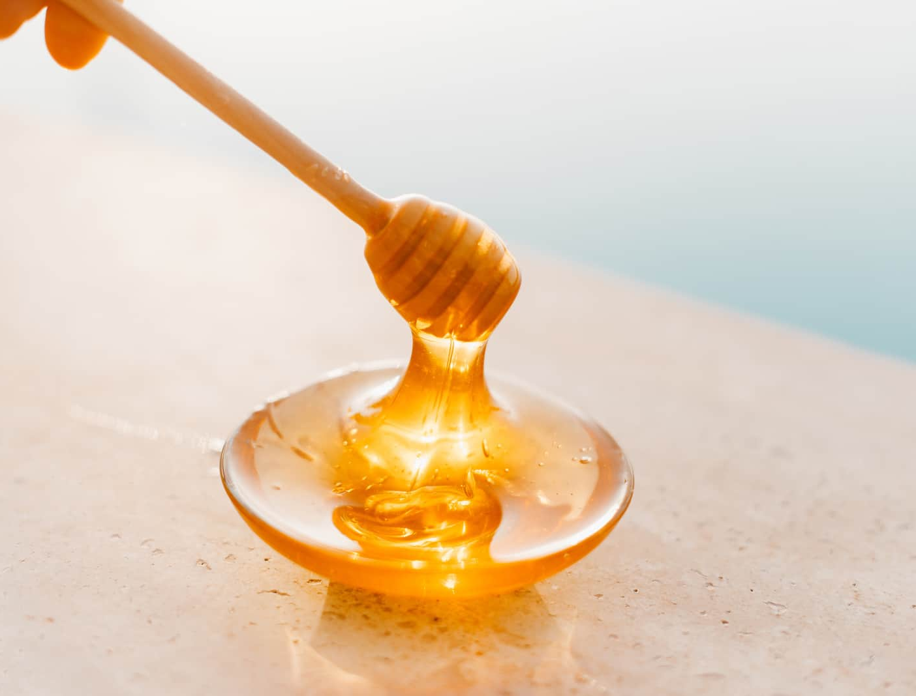
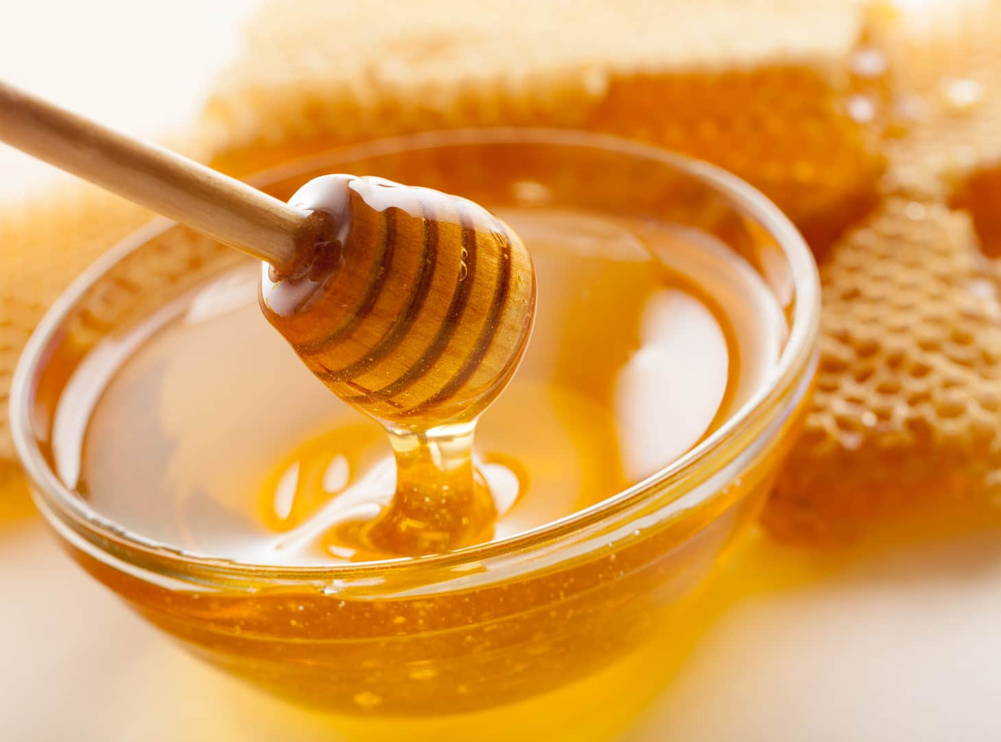
It is highly absorbent and moisturizes deeply into your skin.
Honey
Honey contains vitamins, minerals, and amino acids, all essential for
beautiful skin.

Slide 13
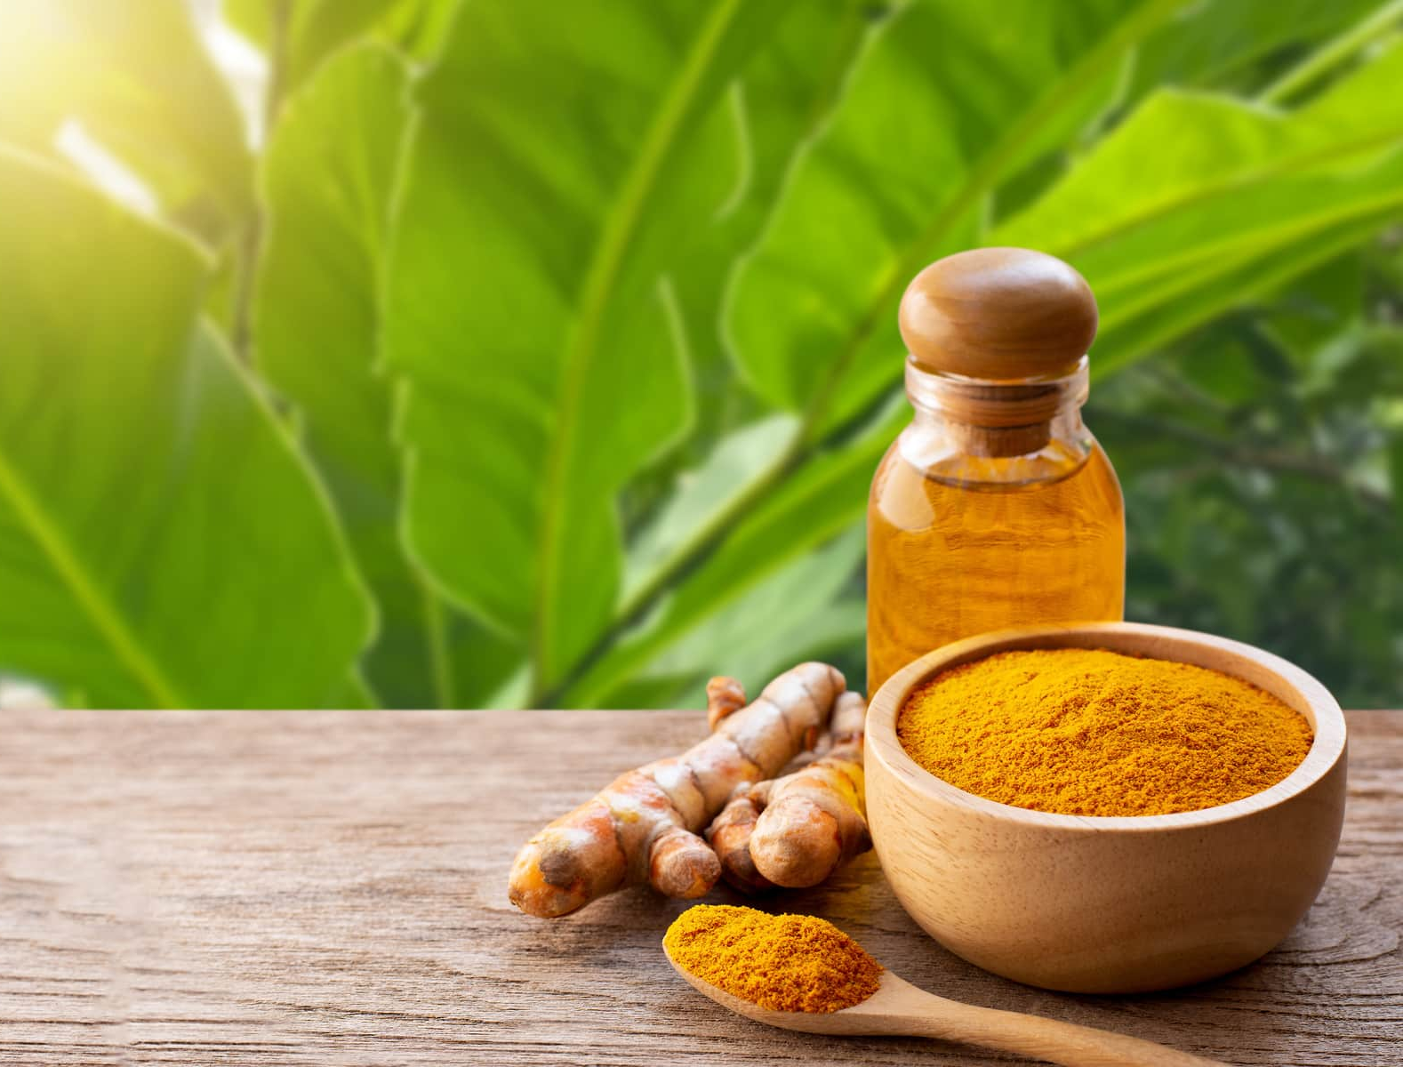
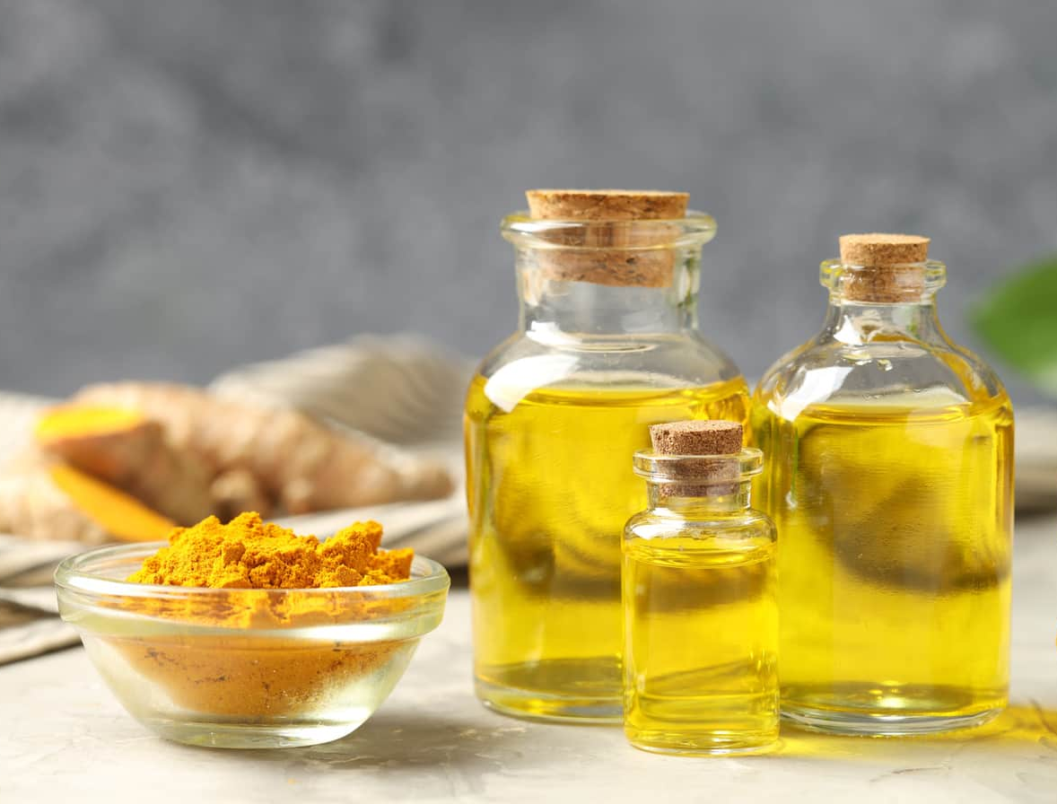
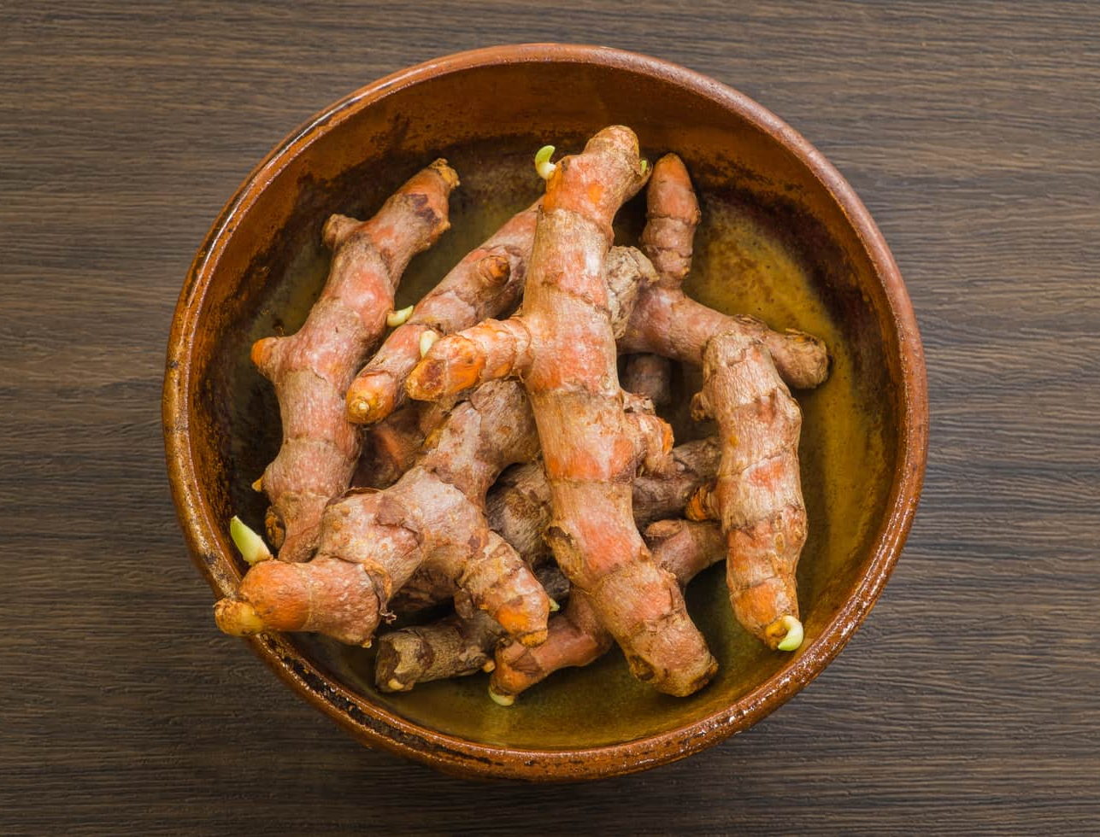
Turmeric Root Oil
Helps soothe irritated skin, making it ideal for sensitive or acne-prone skin.
also known as Curcuma Longa Root Oil.
Curcuma Longa (Turmeric) Root Oil contains vitamins, minerals and is rich in curcumin, which is great for healthy looking skin.

Slide 14
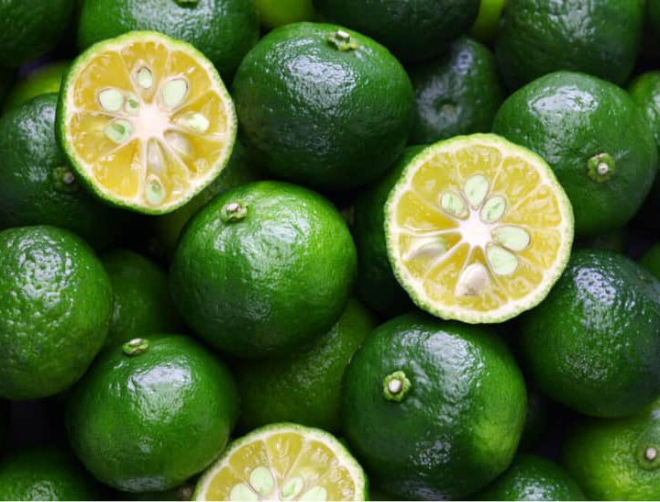
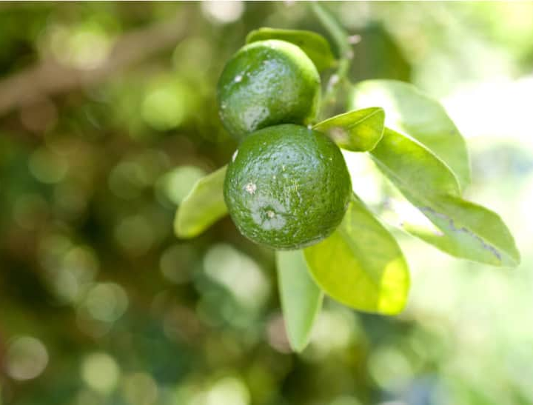
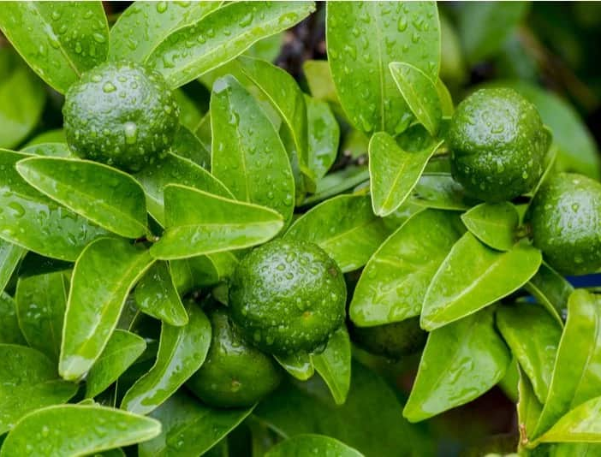
Citrus Depressa Fruit Water
Assists in gently removing impurities while maintaining the skin’s moisture balance.
It contains a variety of nutrients effective for beautiful skin, such as vitamin C, B1, Carotene, and a range of other beneficial minerals.

Slide 15
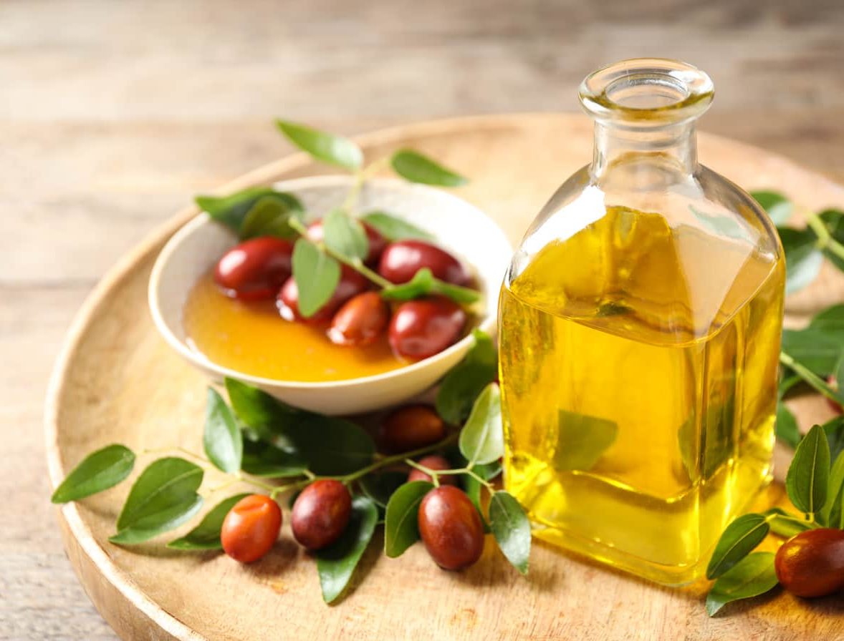
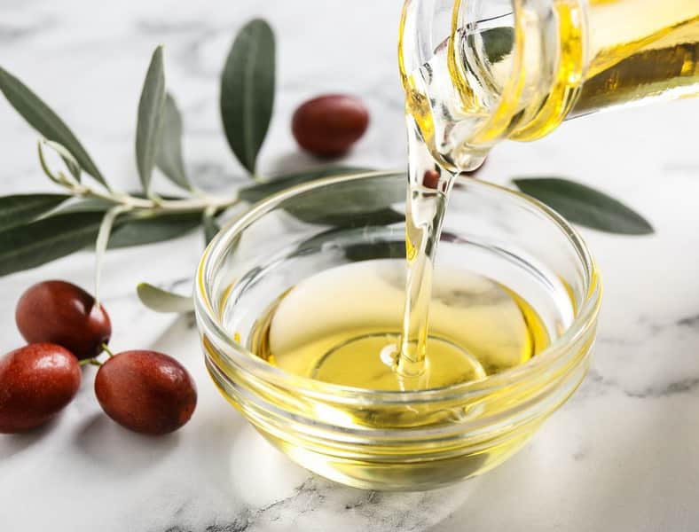
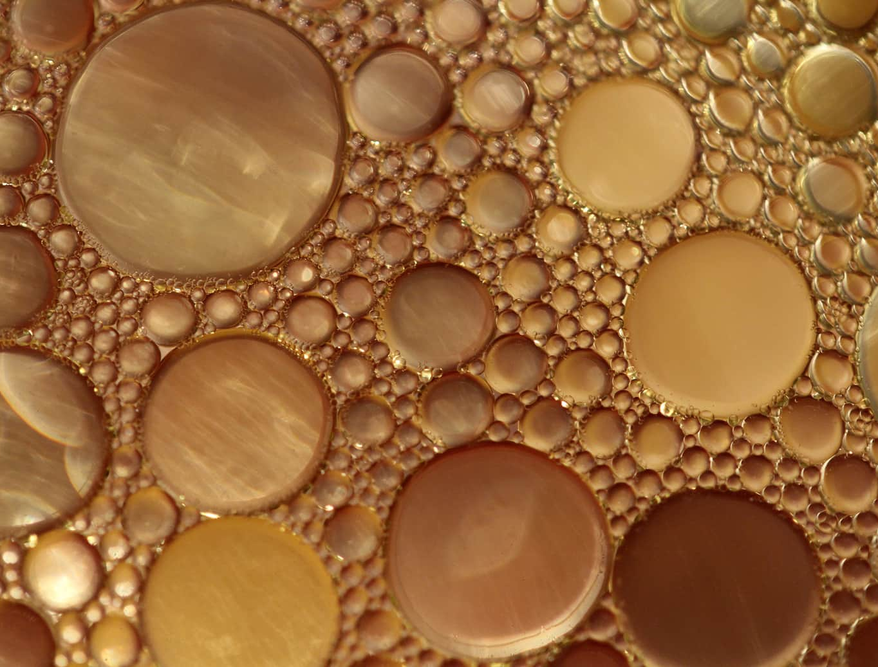
Jojoba Seed Oil
It helps to moisturize skin without clogging pores and contains vitamin E and antioxidants.
also known as Simmondsia Chinensis Seed Oil.
It is lightweight, non-comedogenic, and suitable for all skin types.

Slide 16
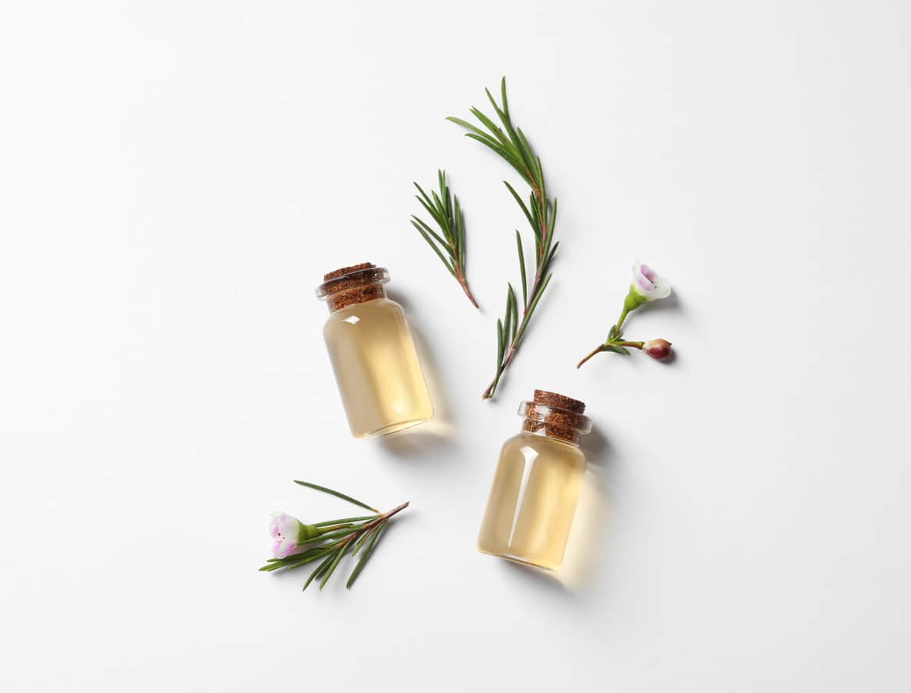
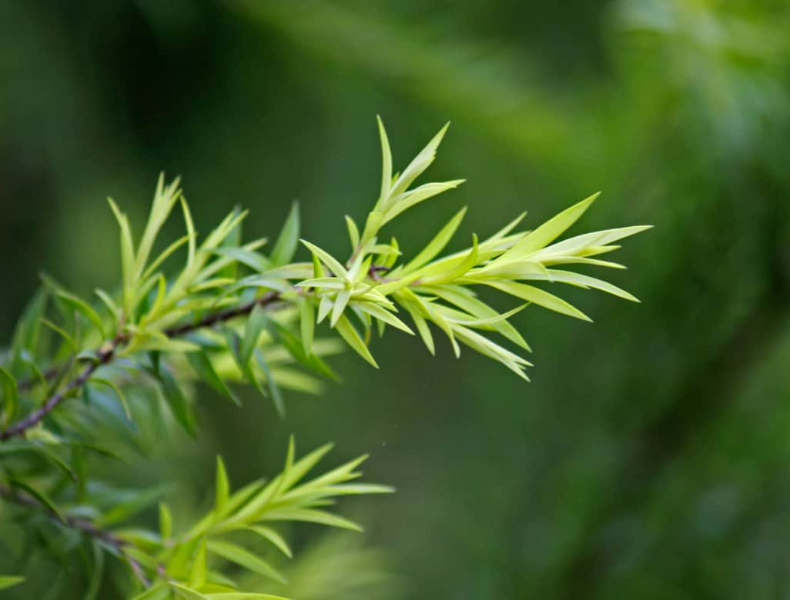
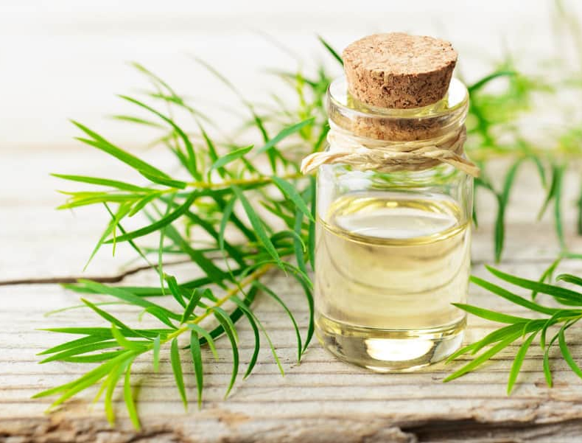
Tea Tree
Leaf Oil
It is great for oily or acne-prone skin but gentle enough for daily use.
also known as Melaleuca Alternifolia Leaf Oil.
It is a popular natural ingredients known for its antimicrobial property.

Slide 17
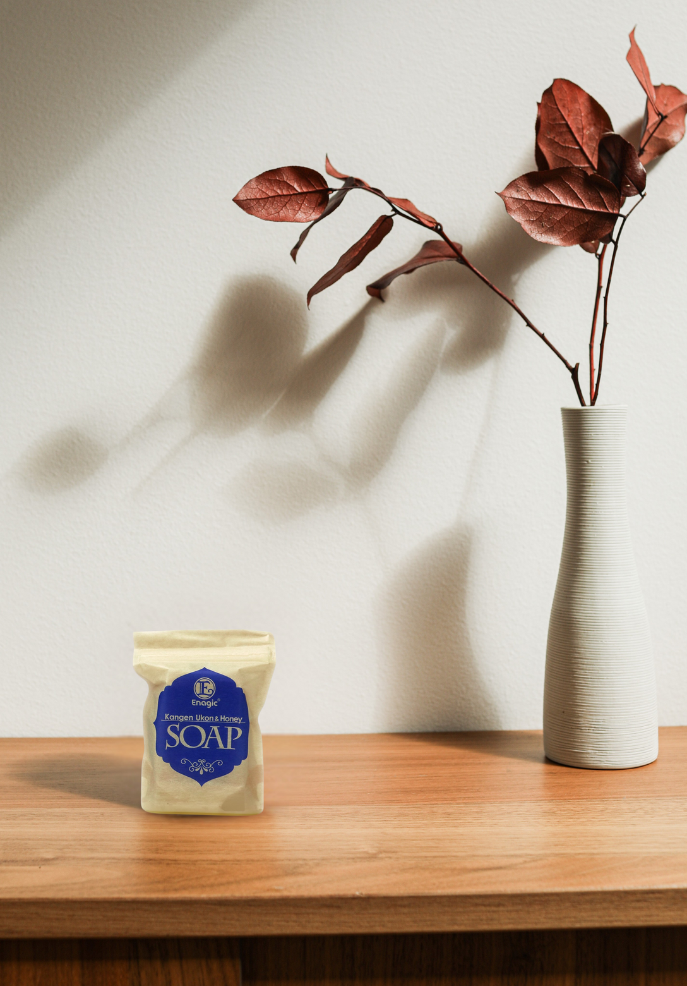
KANGEN UKON & HONEY SOAP
BENEFITS
Helps to revitalize and nourish the skin, promoting a more youthful and healthier looking skin.
This gentle blend is suitable for full-body cleansing-including hands and face-thanks to its mild, non-irritating formula.
Formulated with just 9 natural ingredients, this soap offers a pure, high-quality cleanse that’s gentle on the skin yet powerfully effective.

Slide 18
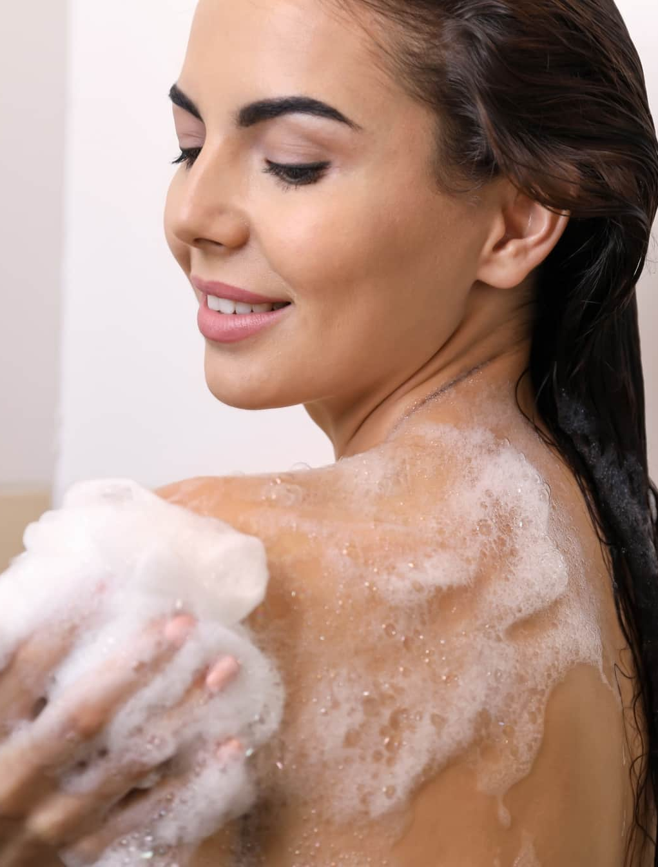
It can be used for
whole-body cleaning.
After lathering with your hands or a towel, rinse thoroughly with
cool or hot water.
DIRECTION OF USE
KANGEN UKON & HONEY SOAP

Slide 19
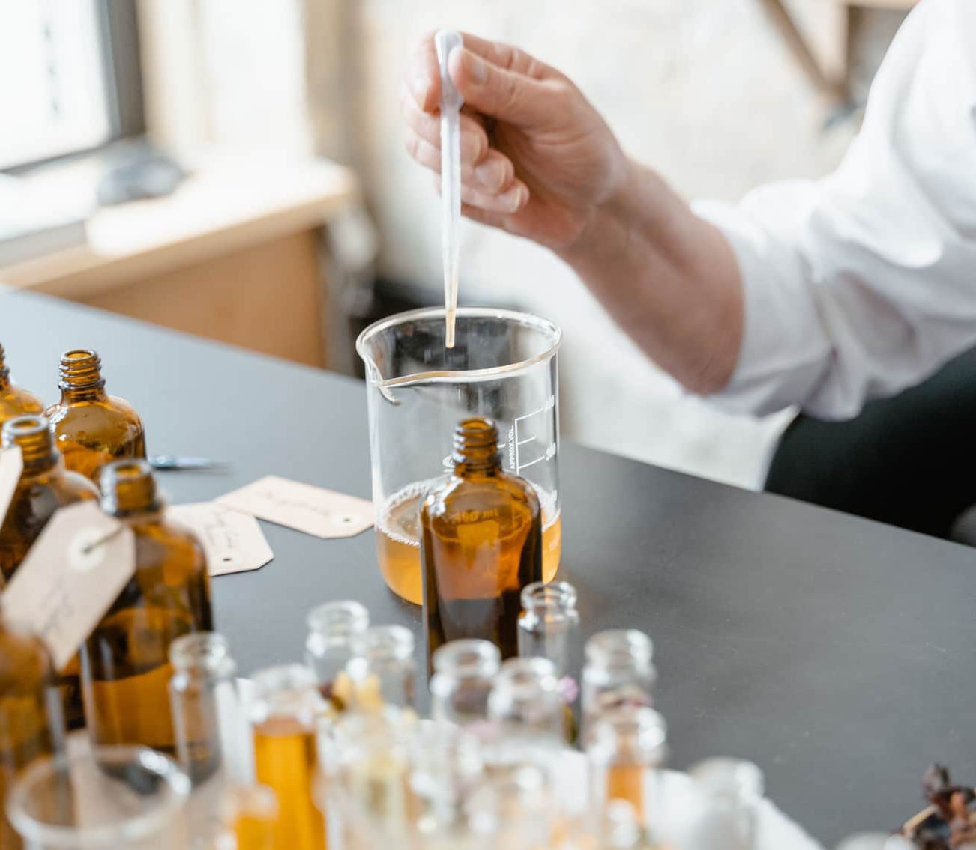
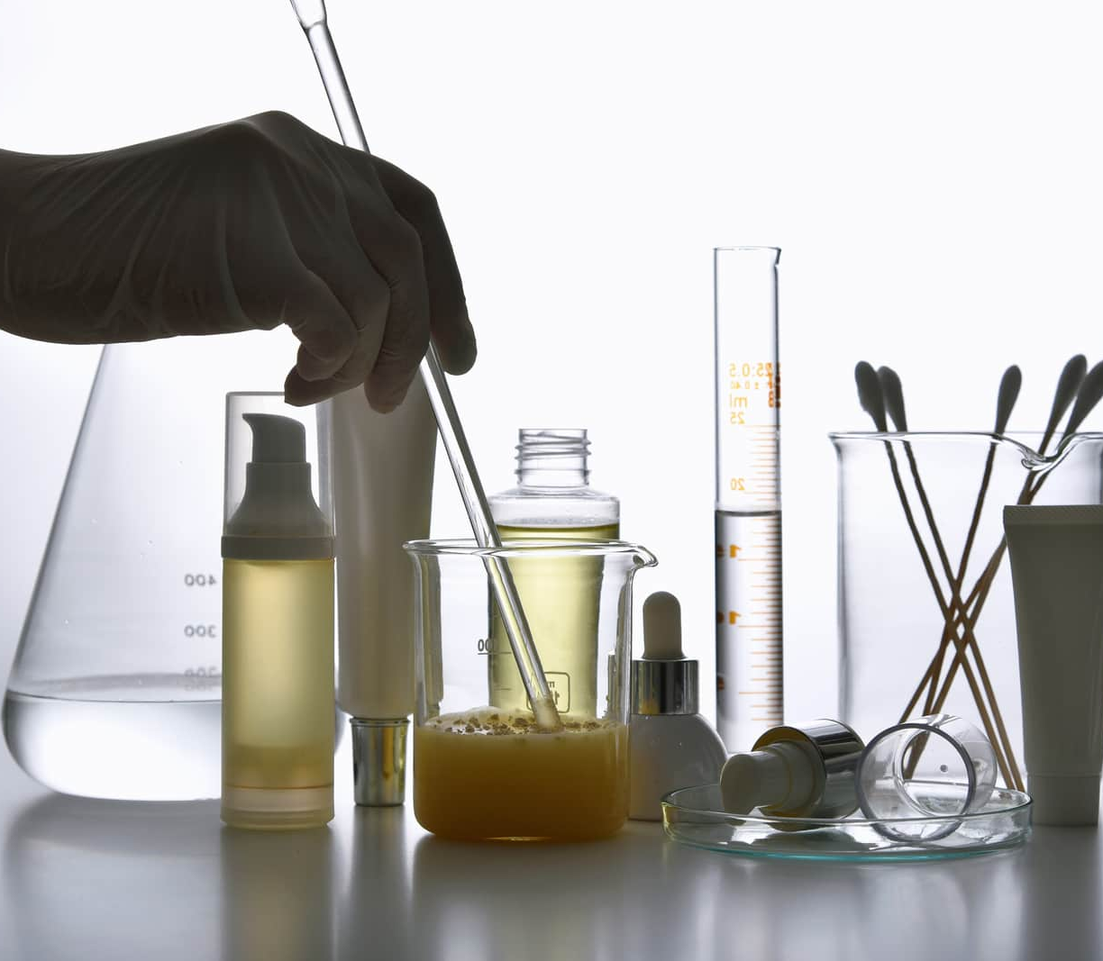
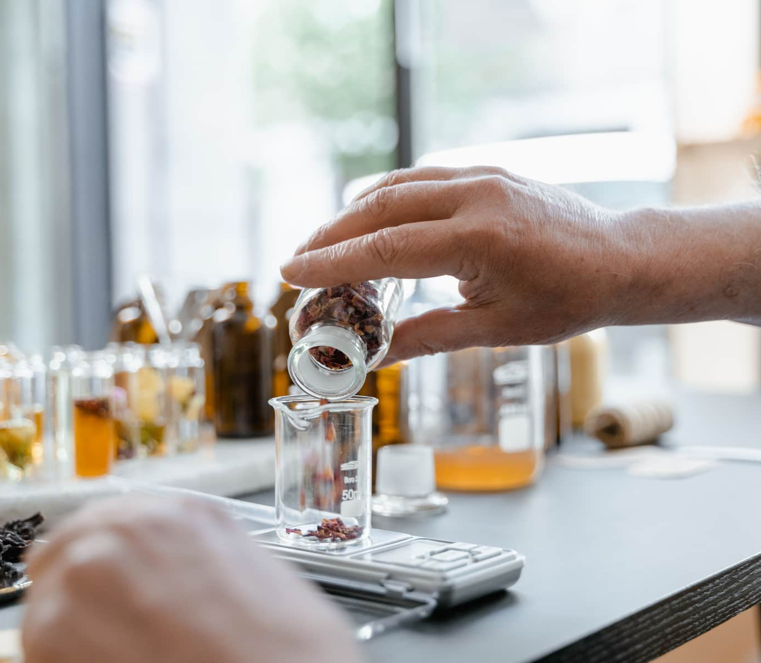
Discontinue use if any changes in skin condition occur or if skin redness or irritation develops.
If the product gets into the eyes,
rinse immediately.
WARNINGS

Slide 20
OUR PRODUCT

Slide 21
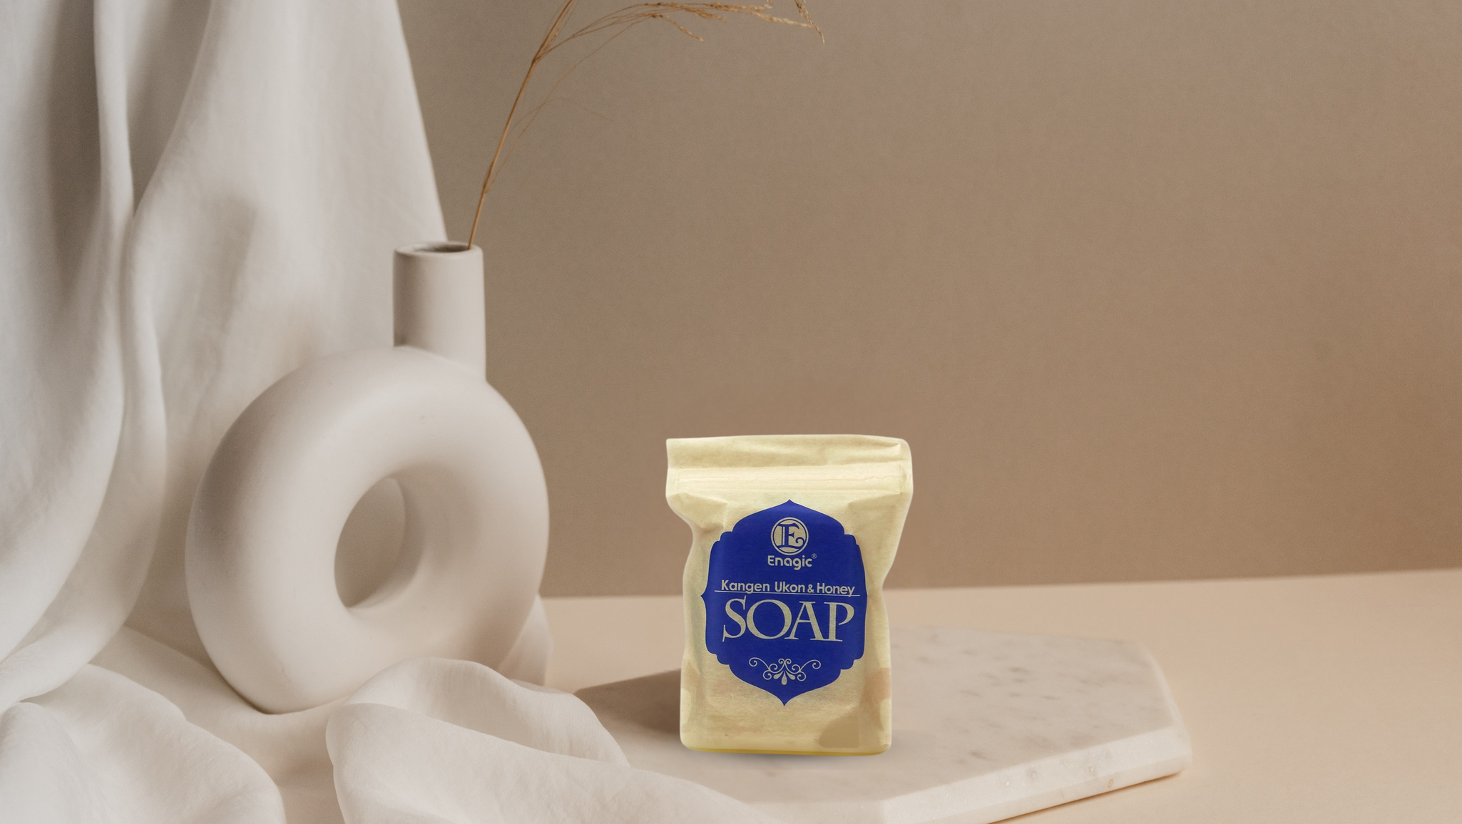
Visit our website; www.enagic-my.com for more information.
KANGEN UKON & HONEY SOAP
Experience the power of Kangen Ukon, Honey and Citrus Depressa in all natural living soap made to rejuvenate your skin!

