Slide 1
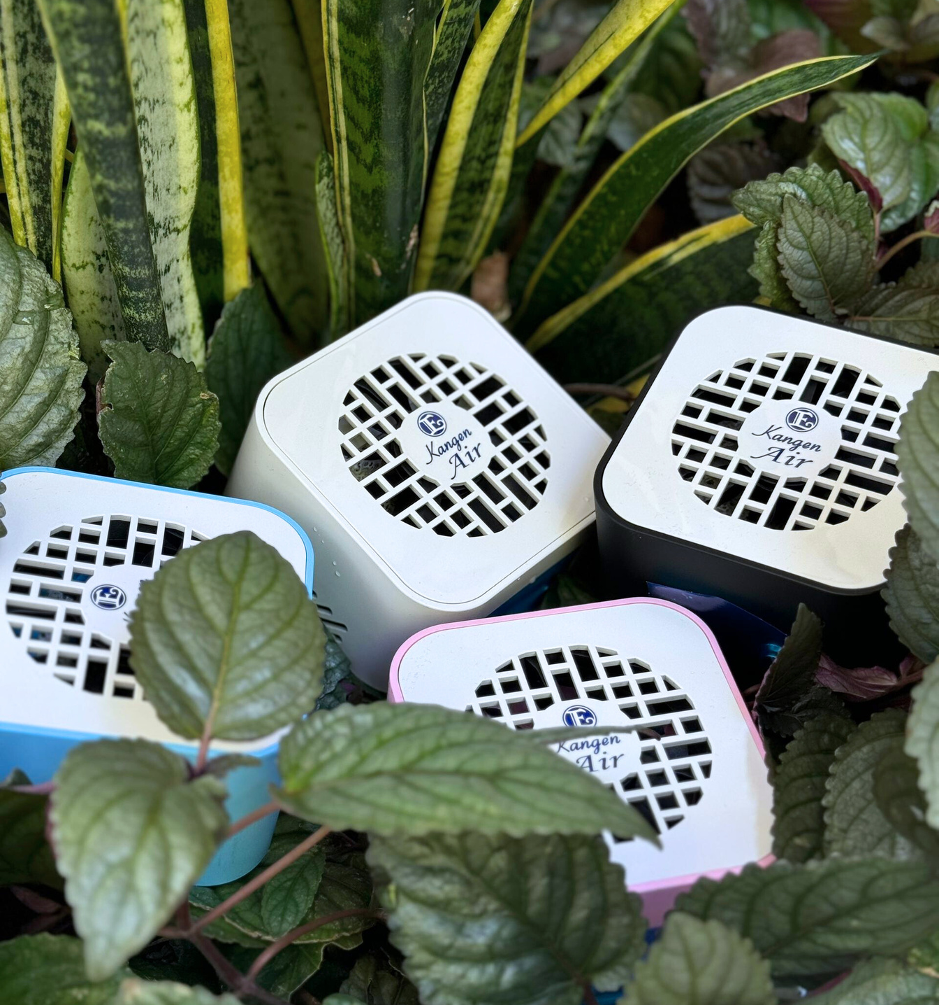
Enagic Malaysia Sdn. Bhd.
201101042983 (971103-W) AJL No. 931978
Air
Kangen
Experience the Sensation of Fresh Air

Slide 2
Kangen Air is a new type of air purifier that combines photocatalyst technology with UV LED.
Through photocatalytic oxidation with
TiO2 and UV LED, harmful substances
and odours are decomposed into clean air.

Slide 3
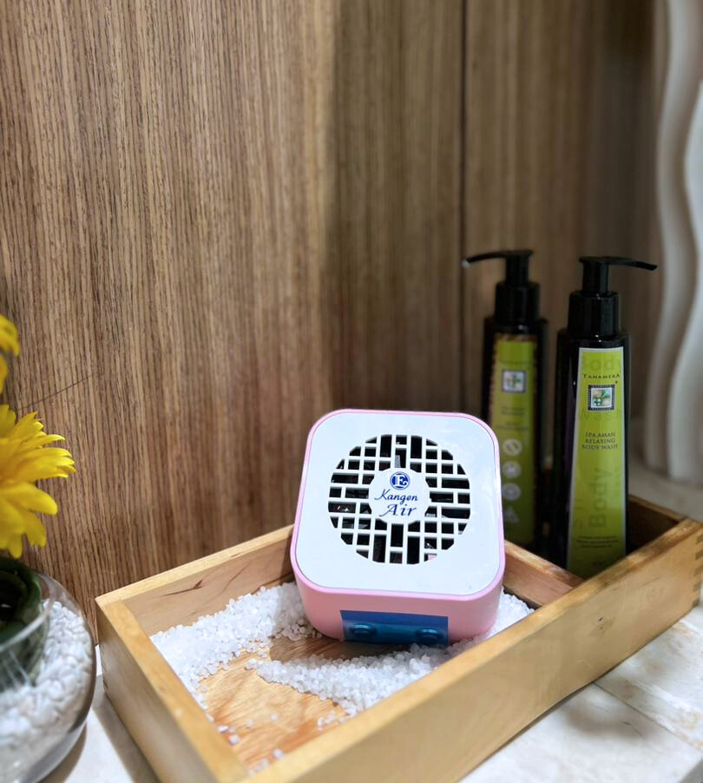
Features:
Low Running Cost
Quiet Operation
Lightweight
Deodorization and Sterilization
Maintenance-Free
Versatile Use

Slide 4
Kangen Air decomposes various odours in daily spaces, making it effective in many situations.
Pet Odours
Toilet Odours
Human Odours
Kitchen Odours
Tabacco Odours
Mold Odours
Diapers Odours
Garbage Odours
Shoe Odours
Car Odours
etc

Slide 5
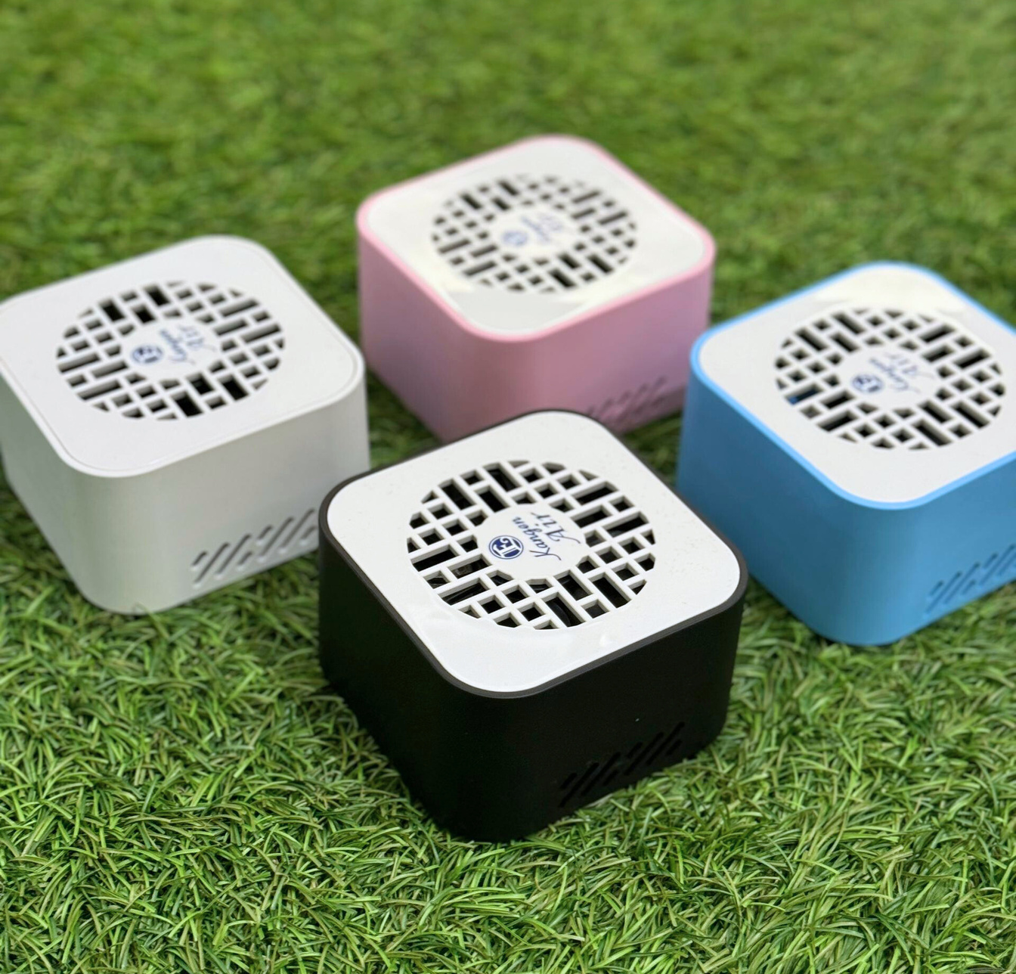
Each set comes with four units of Kangen Air
Black
Blue
Pink
White

Slide 6
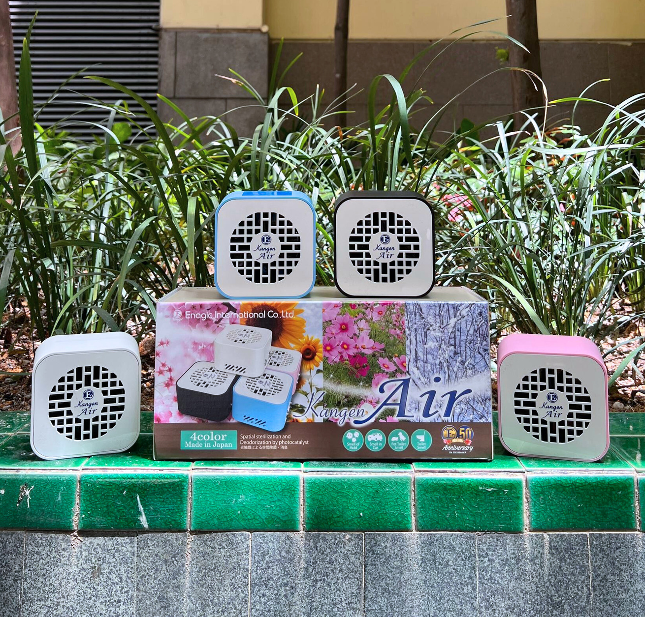
Kangen Air is specifically designed and made in Japan.

Slide 7
Kangen Air is a
LIMITED EDITION PRODUCT.
Pure Air, Pure Bliss!
Visit our website; www.enagic-my.com for more information.

